Slide 1
ECOLOGY (Part – 2)
Dr. Prasenjit Adak

Slide 2
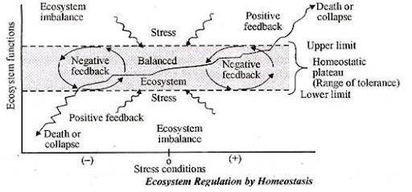
Homeostasis
The ecosystem , by itself, tries to resist the change and maintain itself in equilibrium.
Positive feedback
Negative feedback

Slide 3
Succession
Ecological succession is the gradual process by which ecosystems change and develop over time.
It is therefore a series of predictable temporary communities or stages leading up to a climax community.
Each stage/temporary community is called a successional stage or seral stage.
Each step prepares the land for the next successional stage.
All habitats are in the state of constant ecological succession.

Slide 4
Succession
An established species and impact of external natural forces, which try to alter the environmental condition of that area. Ex. Hardwood tree replacing red pine
Ecosystem is continuously changing and reorganizing as well as ecological succession refers to orderly that changes happening in composition or structure of ecosystem

Slide 5
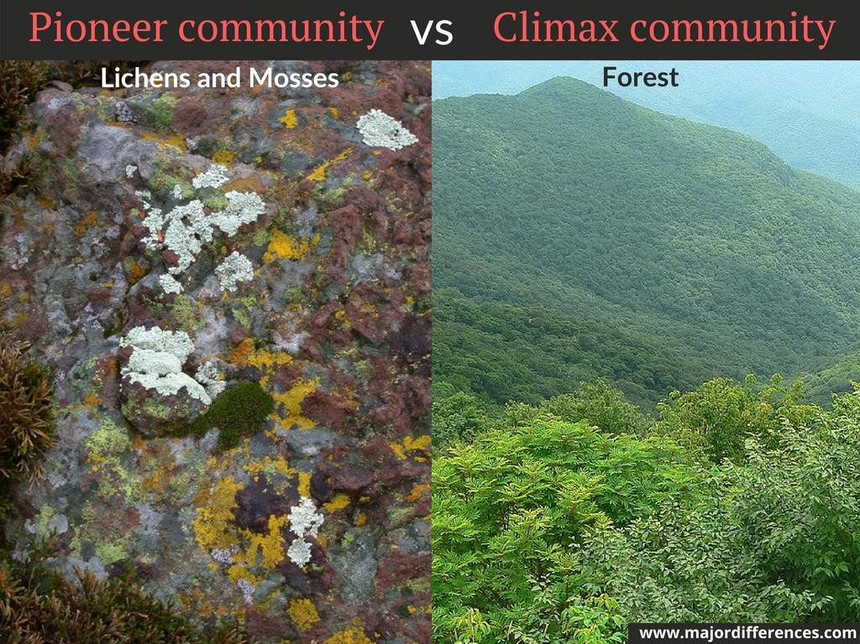
Types of Succession
Primary succession
Primary succession refers to a series of community changes which occur on an entirely new habitat which has never been colonized before. For example, a newly quarried rock face or sand dunes. (pioneer and climax community).
Secondary succession
Secondary succession refers to a series of community changes which take place on a previously colonized, but disturbed or damaged habitat. For example, land obtained after felling trees in a woodland, land clearance, or fire.

Slide 6
Succession starting on different types of area
Hydrarch / Hydrosere
Pond, swamp, bog
Mesarch / Mesosere
Area with adequate moisture
Xerarch / Xerosere
Lithosere: On bare rock
Psammosere: On sand
Halosere: On saline soil

Slide 7
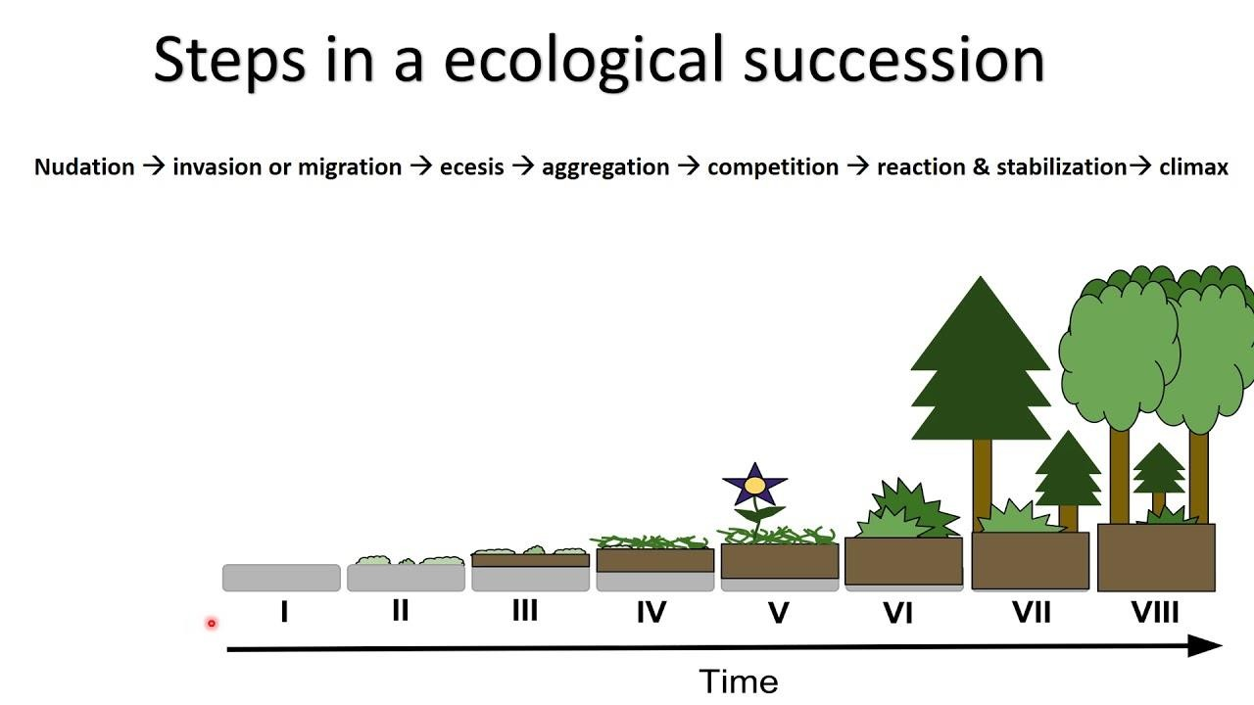
Process of ecological succession
Nudation
Invasion
Migration (dispersal)
Ecesis (establishment)
Aggregation
Competition
Reaction
Stabilization

Slide 8
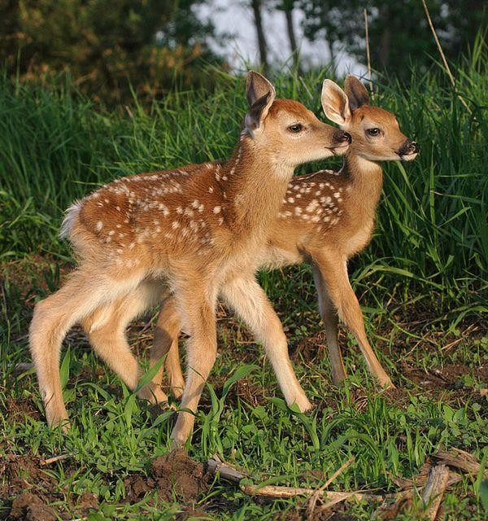
Forest ecosystem
Abiotic Components
Inorganic and organic substances found in soil
Temperature, humidity, rainfall, light
Biogenic gases (CO₂, O₂)
Biotic components
Producers: Large trees, herbs, lianas (climbers), Orchids
Primary consumer: Deer, Elephant, moles etc.
Secondary consumer: Snake, Lizards etc.
Tertiary consumers: Tiger, Lion etc.
Decomposers

Slide 9
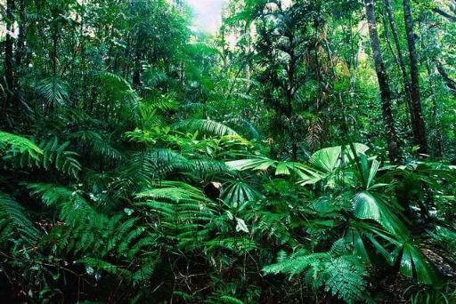
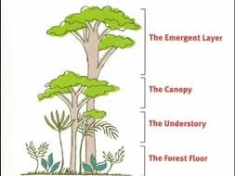
Tropical rain forest
Notable features:
Found in tropical region (near the equator).
High rainfall, humidity and temperature
Large leaves
Rich in biodiversity
Fauna of these rainforests includes the jaguar, tapir, okapi, boa constrictor, African grey parrot, keel-billed toucan, crowned eagle, three-toed sloth, spider monkey, large flying fox and more.
Layers
Emergent layer
Canopy
Understory
Forest floor
Example: Amazon Rainforest, Congo Rainforest, Southeast Asian Rainforest etc.

Slide 10
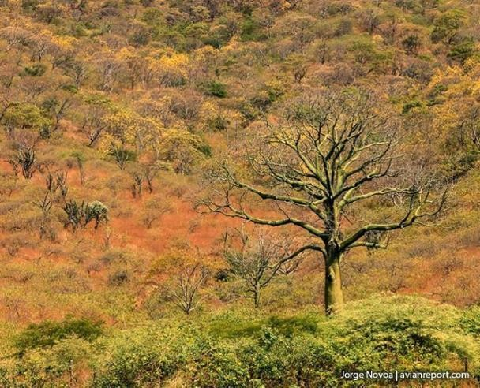
Tropical deciduous forest
Notable features:
Tropical deciduous forests form a natural cover almost all over India.
They are of two types-moist and dry. Moist forests are found on the eastern slopes of Western Ghats, North eastern parts of the Peninsular Chhota Nagpur plateau and along the Shiwaliks.
They shed there leaves for a particular period of time.
They are economically very important because of timber like sal and teak.
The animals found here are tiger, wolves, rabbit etc.

Slide 11
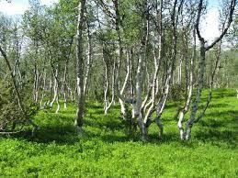
Sub-tropical forest
Notable features:
Subtropical forests are within or
bordering the tropical zone.
temperatures may vary only slightly over a year
Subtropical rainforests occur in Central America, the West Indies, India, Madagascar, mainland Southeast Asia, and the Philippines.
Small deciduous trees and shrubs are found.

Slide 12
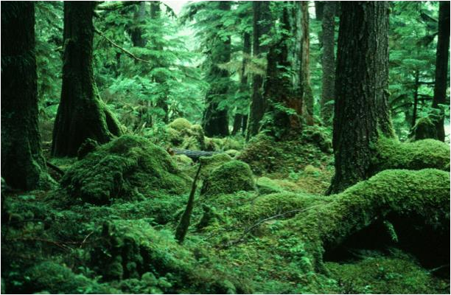
Temperate rain forest
Notable features:
The world's largest temperate rain forests are found on the Pacific coast of North America.
Temperate rain forests are also found in coastal Chile, Norway, the United Kingdom, Japan, Australia and New Zealand.
The mild weather conditions
Adequate rainfall
Coniferous trees dominate the forest
tall evergreen trees are also found
Animals: black bears, lynx, wolves etc.

Slide 13
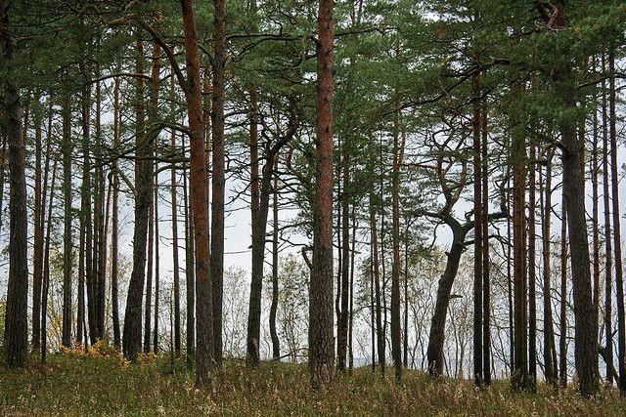
Temperate deciduous forest
Notable features:
Located in the mid-latitude areas (between the polar regions and the tropics). E.g.- Northeast China Plain (China), The Manchurian mixed forest (Asia), The European Temperate Deciduous Broadleaf Forest (Europe)
The temperature varies widely from season to
season with cold winters and hot, wet summers.
During the fall, trees change color and then lose their leaves.
Most of the trees are broadleaf trees such as
oak, maple, beech, hickory and chestnut.
Animals: toad, chipmunk, gray squirrel, Yellow- breasted chat etc.

Slide 14
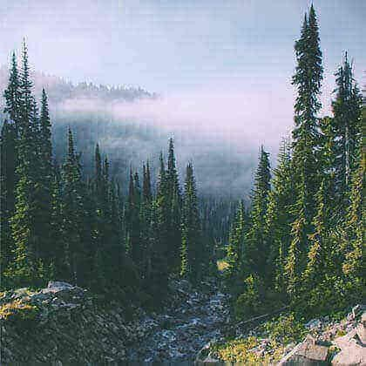
Evergreen coniferous forest
Notable features:
They are found just in south of arctic tundra
Winters are long, cold and dry
Sunlight is available for few
hours only
Soil has less nutrient and acidic
Major trees are Pine, Fir, Cedar etc.
Animals: moose, deer, reindeer, squirrels, wolves, bears, foxes, owls, woodpeckers hawks etc.

Slide 15
Grassland ecosystem
Abiotic components:
Inorganic elements (C, H, O, N, P, S)
Temperature, humidity, rainfall, light
Biotic components:
Producers: Some scattered trees, Grass
Primary consumers: Grazing animals,

Slide 16
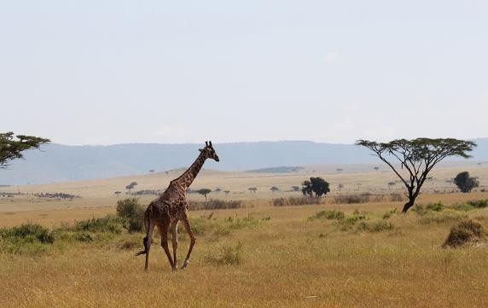
Tropical grassland
Notable features:
Located near the equator, between the Tropic
of Cancer and the Tropic of Capricorn.
Although these areas are overall very dry, they do have a season of heavy rain.
Dominated by grasses
May have some drought-resistant, fire-
resistant trees
Animals: giraffes, zebras, buffaloes, kangaroos, mice, moles, gophers, ground squirrels, snakes, worms, termites, beetles, lions, leopards, hyenas, and elephants.
Examples:
Savannas

Slide 17
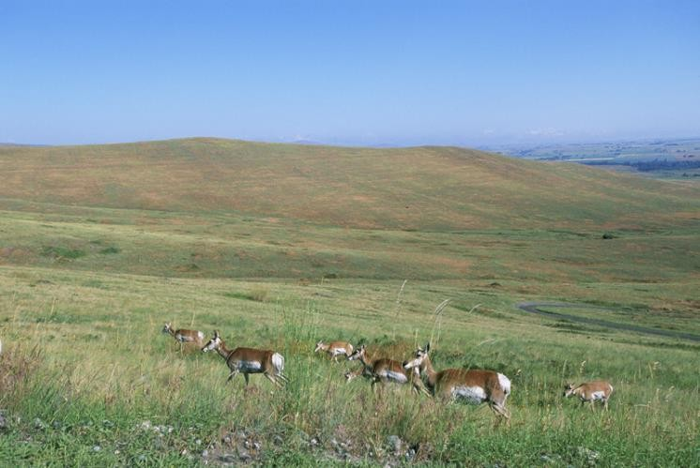
Temperate grassland
Notable features:
Trees and shrubs are completely absent or rare.
cold winters (-40⁰C) and hot summers (38⁰C)
Gentle slope
Animals: Rodents, bisons, wolves, hawks, owls etc.
Examples:
Prairies (South America)
Pampas (Africa)
Velds (Central Europe)
Steppes (Asia)

Slide 18
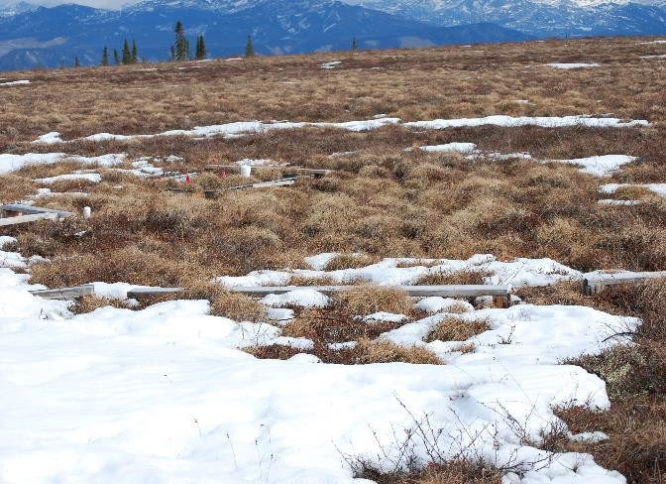
Polar grassland
Notable features:
Severe cold and strong wind
Arctic wolf, arctic fox, reindeer, migratory birds and insects are found.
Examples:
Arctic Tundra
Permafrost: Permafrost is soil, rock or sediment that is frozen for more than two consecutive years. In areas not overlain by ice, it exists beneath a layer of soil, rock or sediment.

Slide 19
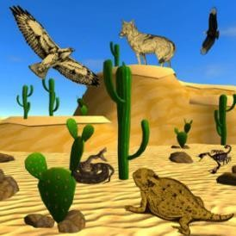
Desert ecosystem
About 1/3rd of the worlds’ land area is covered with desert
Tropical desert
Notable features:
It is the driest and hottest place on earth.
Rainfall is sporadic and in some years no measurable precipitation falls at all.
Examples: Sahara, Kalahari, Thar, Mexican deserts, Great Australian desert.
Temperate desert
Notable features:
Temperate deserts can be much colder than tropical deserts
The floor of the temperate desert is often covered by rocks and small pebbles
Examples: Mojave, Sonoran Deserts
Cold desert
Notable features:
cold deserts occur in temperate regions at higher latitudes
hot summers but extremely cold winters.
Examples: Atacama,
Gobi, Great Basin, Namib, Iranian, Takla Makan, and Turkestan

Slide 20
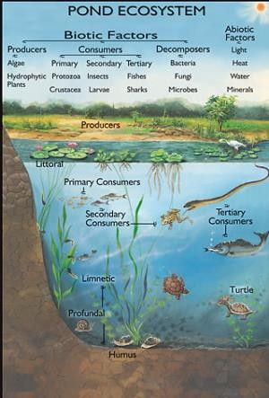
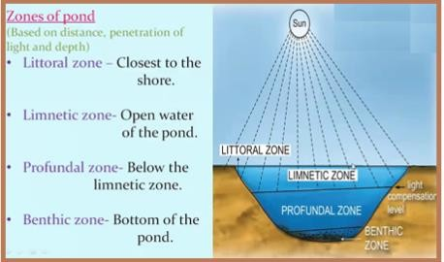
Pond ecosystem
A pond ecosystem refers to the freshwater ecosystem where there are communities of organisms that are dependent on each other and with the prevailing water environment for their nutrients and survival.
Notable features:
Small freshwater ecosystem
Water is stagnant
Can be seasonal
Exposed to anthropogenic activities

Slide 21
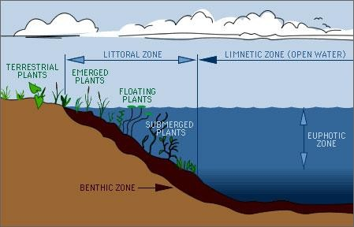
Lake ecosystem
Organisms of aquatic ecosystem
Planktons (Algae, rotifers)
Nektons (Fishes)
Neustons (Water flea)
Benthos (Snail)
Periphytons (Crustaceane)
Zonation (Stratification)
Epilimnion (Warm, lighter, circulating surface layer)
Hypolimnion (Cold, viscous, non-circulating bottom layer)

Slide 22
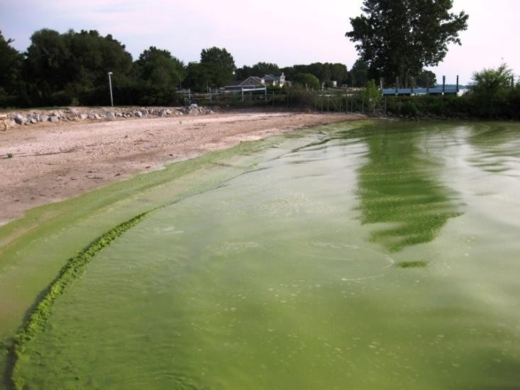
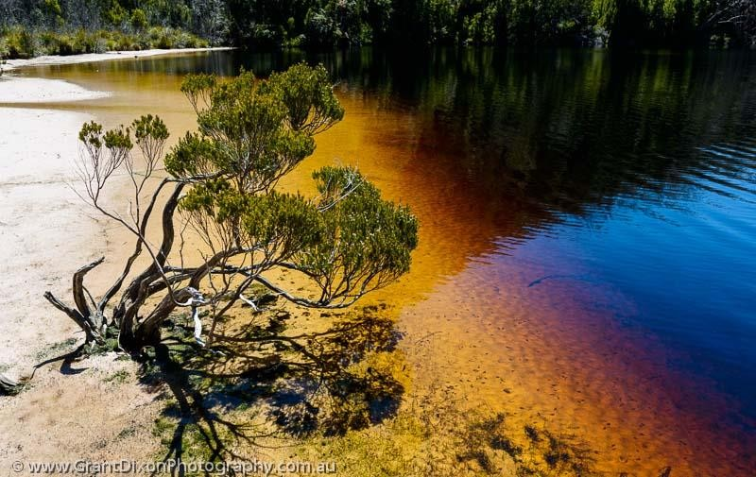
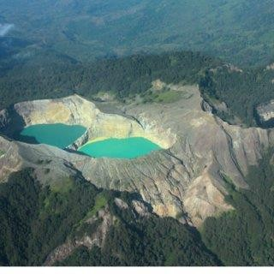
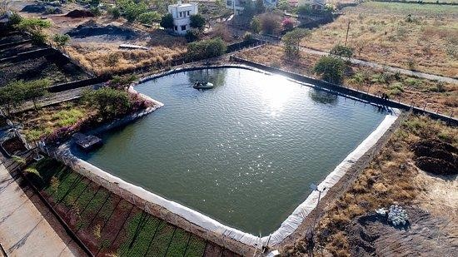
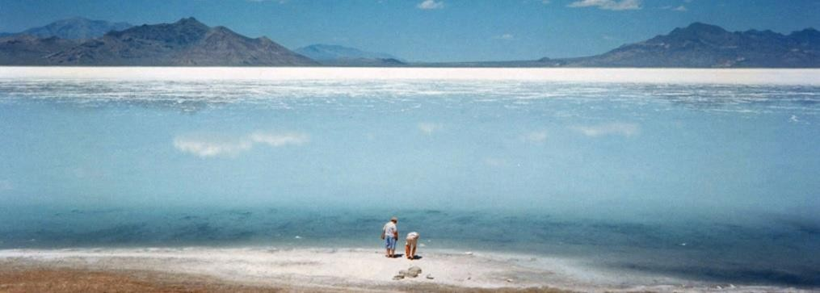
Types of lakes
Oligotrophic lakes (Low nutrient
content)
Eutrophic lake (High nutrient content)
Dystrophic lake (Low pH)
Endemic lakes (Ancient, deep,
having endemic fauna)
Desert salt lakes (High salt content)
Volcanic lakes
Mermictic lakes (Permanently stratified)
Artificial lakes

Slide 23
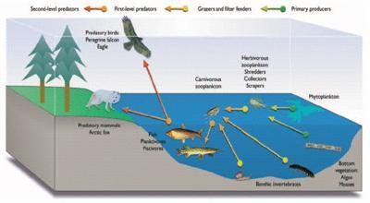
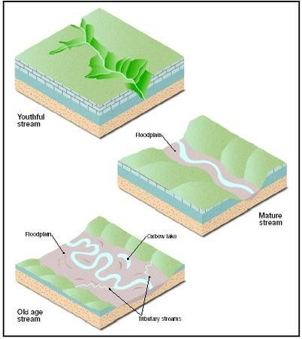
Streams
Notable features:
flowing water that is mostly unidirectional
a state of continuous physical change
many different (and changing) microhabitats
variability in the flow rates of water
plants and animals that have adapted to live within water flow conditions.
Stages
Mountain highland (Young River)
Second phase (Middle Aged River)
Third phase (Old River)

Slide 24
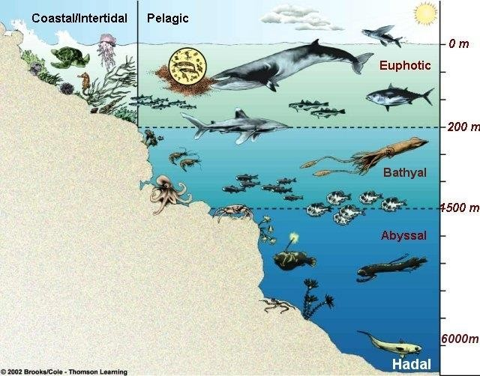
Oceans
Notable features:
Marine ecosystems support a great diversity of life and variety
of habitats.
The ocean is a major influence on weather and climate.
Plants: seaweeds, or marine algae (brown, green, red), sea grasses, phytoplankton
Animals: protozoans, marine invertebrates (echinoderms, mollusks, segmented and non-segmented worms, jellies, coral, sea anemones, hyroids) marine vertebrates (fishes, birds, mammals), and zooplankton.
Zones
Coastal zone
Open sea
Euphotic zone (Abundant sunlight, high photosynthetic activity)
Bathyal zone (Dim light)
Abyssal zone (Dark zone)

Slide 25
Thank You

